Slide 1
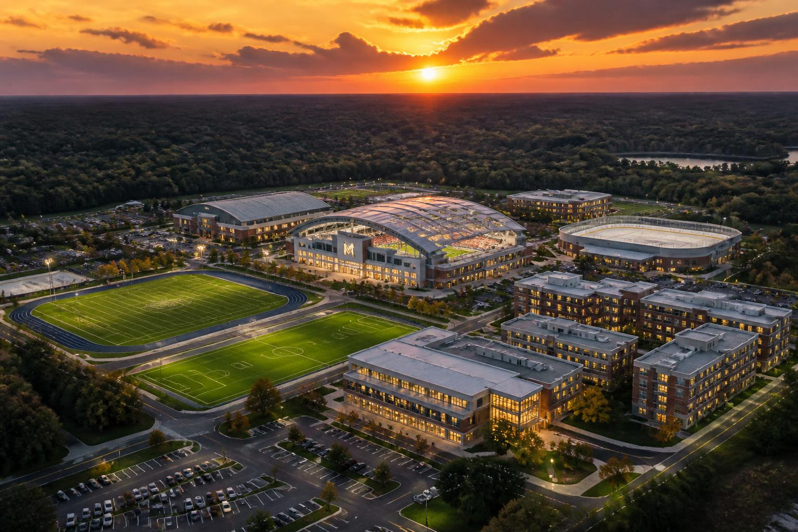

LAB 618
Campus & Sports Facility Complex
47.7 acres • Madison, Illinois • 2025

Slide 2
THE OPPORTUNITY
A campus for the next generation of student-athletes.
47.7-acre semi-developed site in Madison, IL.
Direct access to I-55, I-70, and I-64.
Within 20 minutes of downtown St. Louis and Lambert.
No comparable multi-sport campus within 2 hours.
LAB 618 • Madison, IL
2 / 12

Slide 3
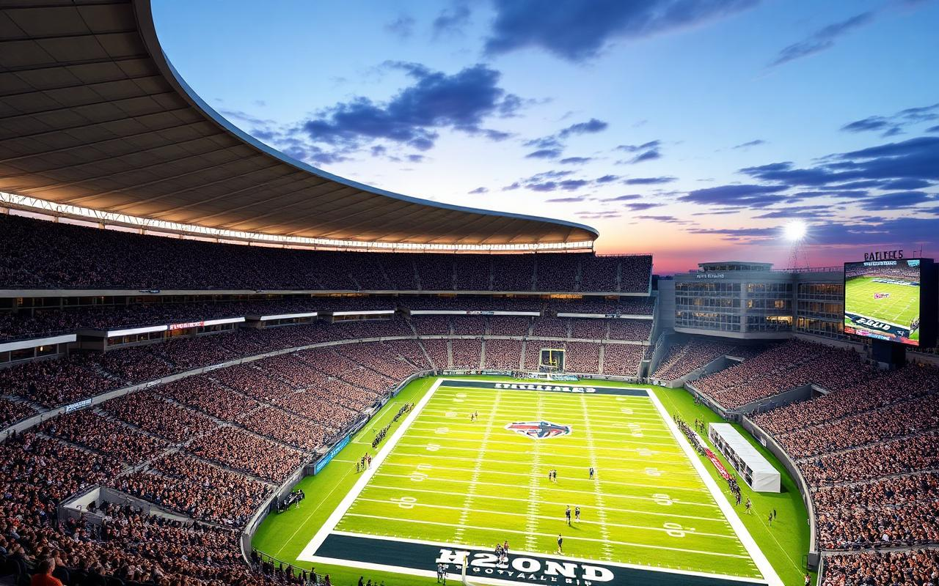
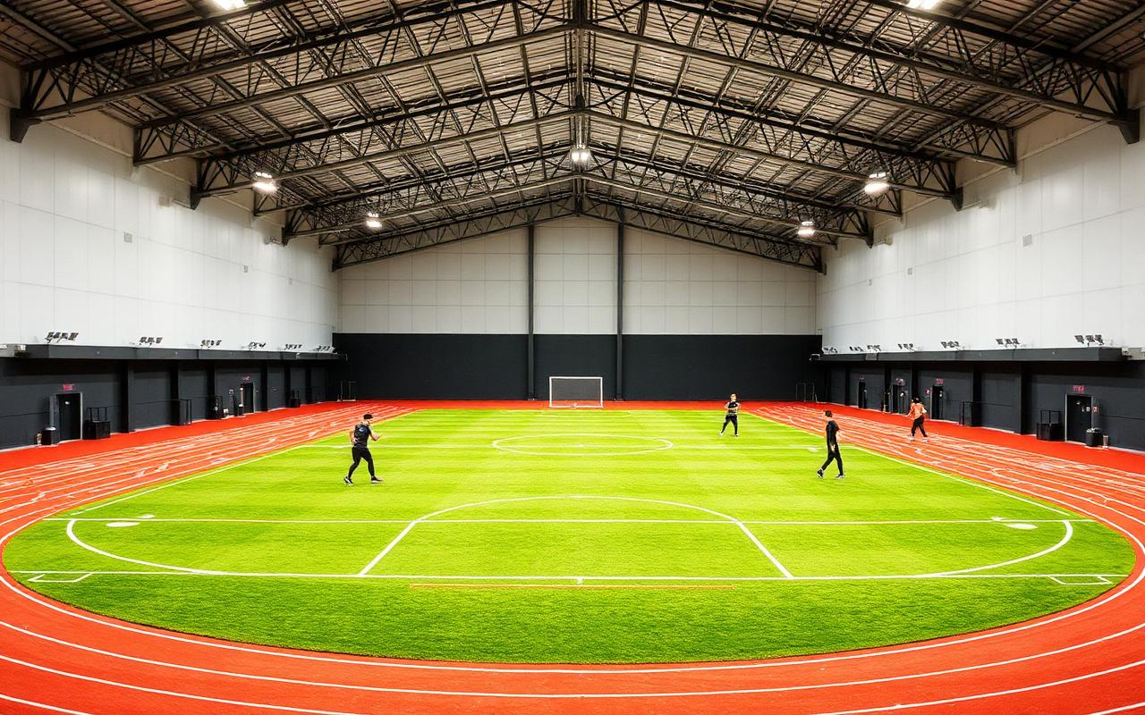
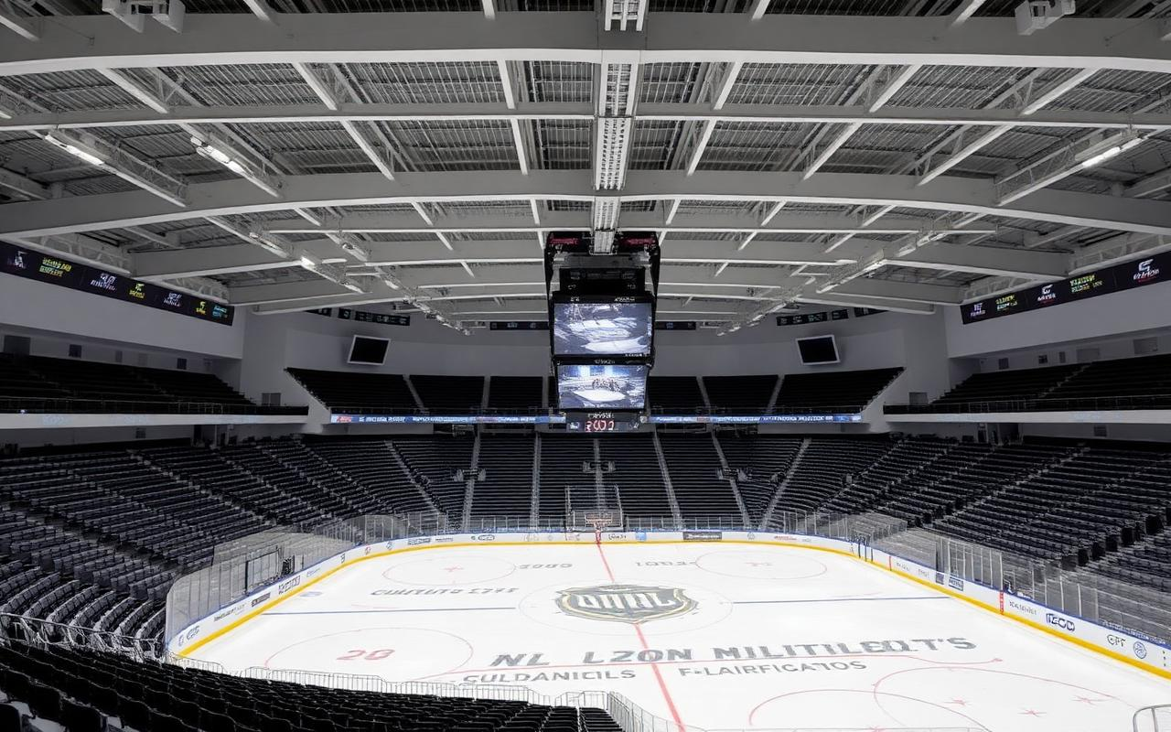
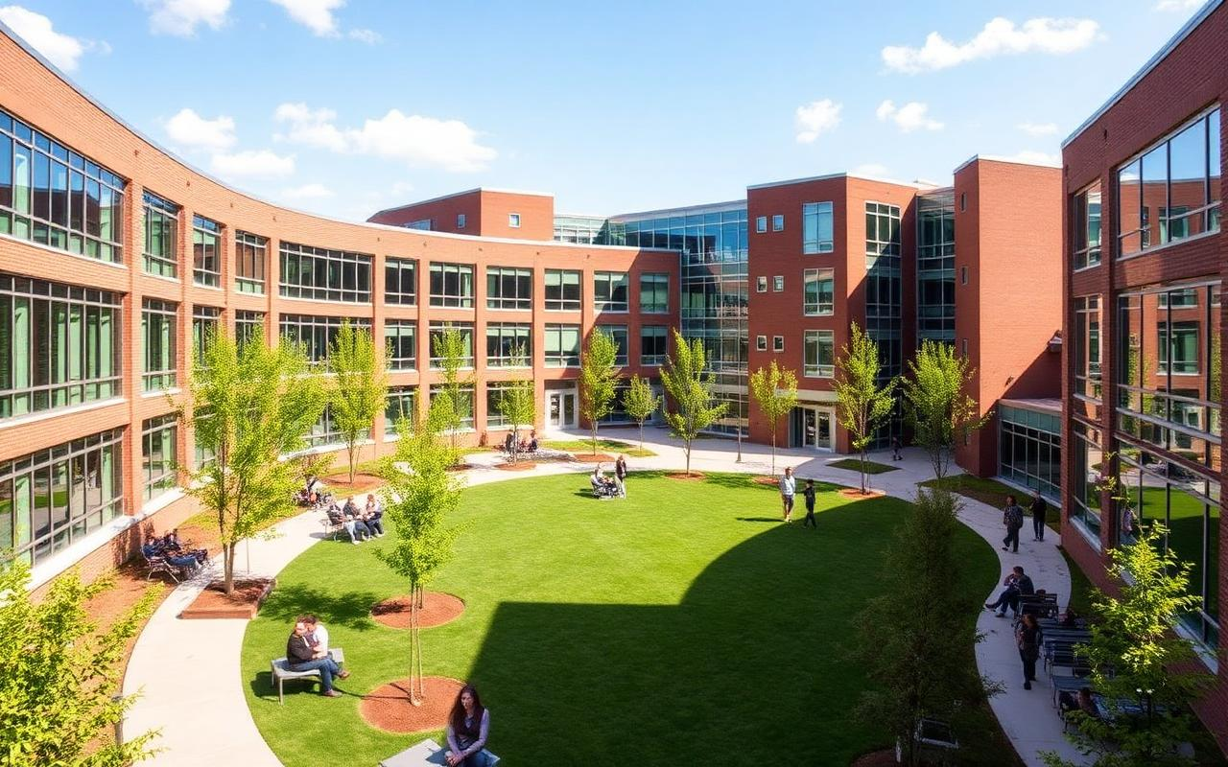
MASTER PLAN
Six anchor facilities on one campus
Outdoor Stadium
Indoor Fieldhouse
17,000 seats, arched roof, synthetic turf.
Multi-purpose turf + perimeter running track.
Ice & Aquatics
Classrooms & Housing
1,800-seat hockey arena, competition pool.
3-story academic buildings, student dorms.
LAB 618 • Madison, IL
3 / 12

Slide 4
FACILITY 01
Outdoor Football Stadium
Seating capacity: 17,000.
Arched roof structure with premium sightlines.
Synthetic turf field with track integration option.
LED scoreboards, broadcast-ready lighting, concessions.
Parking: 425 spaces dedicated, plus shared.
LAB 618 • Madison, IL
4 / 12

Slide 5
FACILITY 02
Indoor Sports Fieldhouse
Multi-purpose synthetic turf surface.
Perimeter running track.
Football, soccer, lacrosse, training, combines.
Year-round programming for athletes and community.
LAB 618 • Madison, IL
5 / 12

Slide 6
FACILITY 03
Ice Rink & Natatorium
Hockey rink with 1,800 spectator seats.
Competition natatorium with spectator deck.
Public skate, learn-to-swim, and league programming.
Potential off-site siting to optimize traffic & parking.
LAB 618 • Madison, IL
6 / 12

Slide 7
FACILITY 04
Classrooms & Student Housing
Three-story academic buildings around a central quad.
Student housing for on-campus athletes and scholars.
Walking-distance access to every athletic facility.
Faculty parking: 130 spaces.
LAB 618 • Madison, IL
7 / 12

Slide 8
PHASING
Built deliberately, opened in stages
I
II
III
IV
Forward Planning
Core Build
Education & Housing
Ice & Aquatics
Master plan, soils, civil, architectural concepts.
Stadium, fieldhouse, outdoor fields, parking.
Classrooms, dorms, central quad.
Hockey arena, natatorium, public programming.
LAB 618 • Madison, IL
8 / 12

Slide 9
BY THE NUMBERS
The scale of Lab 618
47.7
17,000
1,800
Acres of campus
Stadium seats
Arena seats
$271M
3
2.8M
Phases II–IV capital
Interstate corridors
Metro population
LAB 618 • Madison, IL
9 / 12

Slide 10
REVENUE MODEL
Six diversified revenue streams
Stream | Description | Mix
Tuition & Housing | Classroom programs + on-campus dorms | 30%
Events & Tournaments | Game day, rentals, weekend tournaments | 25%
Athletic Programs | Team fees, training, camps, clinics | 20%
Memberships | Community fitness, ice, pool, fields | 10%
Sponsorship & Naming | Stadium, fieldhouse, arena naming | 10%
Concessions & Retail | F&B, merchandise, parking | 5%
LAB 618 • Madison, IL
10 / 12

Slide 11
THE TEAM
Designed by proven partners
Dee Miller
Vision, capital, and community partnerships.
Project Owner — Lab 618
Turf Solutions Group
Peoria, IL. Golf, athletic fields, design, synthetic turf.
Master planning & sports surfaces
Demonica Kemper Architects
James Kemper AIA — stadium, fieldhouse, classrooms.
Architecture & concept design
Austin Engineering Co.
Devin Birch PE — site, storm-water, utilities, grading.
Civil engineering
LAB 618 • Madison, IL
11 / 12

Slide 12
Where training, learning, and the big stage
share one address.
LAB 618 • Madison, Illinois
Contact: hello@lab618.com

